Slide 1
Cells Chapter 2 Quiz Makeup

Slide 2
10 ?’s over photosynthesis
the organs of the plant: functions of leaves, stems, roots, and stomata
location of photosynthesis
Organelle it occurs in
Starting materials (reactants)
Ending materials (products)
Type of cell occurs in
Why photosynthesis is important to humans
Type of energy involved
It is an example of a chemical change (chemical reaction)
Pigment involved with capturing sunlight

Slide 3
8 questions over Cellular Respiration
Types of cells it occurs in
Starting materials (reactants)
Ending materials (products)
How often does it occur (it is always occurring, just faster or slower)
Where does the energy come from
Location (organelle)
Difference in the amount of cellular respiration occurring when you are sleeping versus when you are running
Why does your breathing change when you sleep or when you run?

Slide 4
8 ?’s over Movement of Molecules
All 8 questions are given a scenario, and you tell me if it is an example of diffusion, osmosis, endocytosis, or exocytosis
Make sure you know:
Passive transport (and its goal)
Diffusion (description and examples)
Osmosis (description and examples)
Active transport (and its goal)
Endocytosis (description and examples)
Exocytosis (description and examples)

Slide 5
2 Constructed Response Questions
A seedling with a mass of 100 grams was planted in a large pot of soil. After three months, the mass of the seedling had increased to 500 grams. (2 points total) a. What is the name of the process that caused the increase in the mass of the seedling? b. What are the starting materials (reactants or inputs) the plant used in this process?

Slide 6
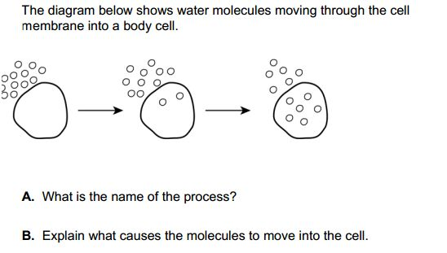
2nd Constructed Response Question

