Slide 1
Sentence Fluency
Sentences that flow smoothly together.

Slide 2
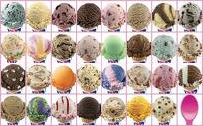
Variety is Good!
Baskin Robbins Ice Cream
Variety in sentence fluency is a number of different lengths, beginnings, and kinds of sentences.
***Think of something else that has a lot of variety. ***

Slide 3
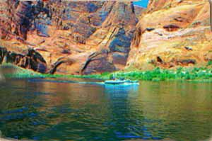
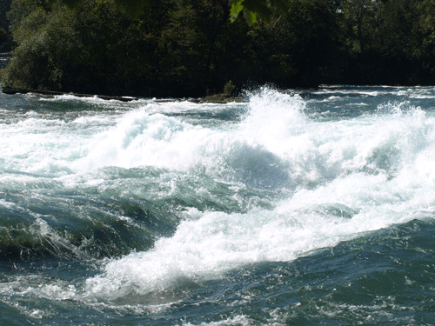
Sentence Fluency
As you flow down the river of your writing, is it choppy and rough or does it flow in a natural pattern?
FLOAT TRIP

Slide 4
EXAMPLE :TEACHER
I am really happy to be your teacher. I hope
we have fun this year. I will teach you many
new things. I am happy you are in my class.
I’m thrilled to be your teacher. This year will
be full of fun and learning. It is exciting to
have you in my class.

Slide 5
EXAMPLE: DOG
I have a dog. Her name is Stella. She is a
Beagle. She is black, brown, and white. She
likes to play catch with me.
I have a black, brown, and white Beagle
named Stella. She likes to play catch with
me.

Slide 6
EXAMPLE: BEACH
We went to the beach. It was sunny. It was warm. We had fun. We flew kites. We ate
snacks.
We spent a warm day at the beach. When
we got hungry, we ate a snack. Later on, we
flew kites high in the sky. It was a great day!

Slide 7
EXAMPLE: BASEBALL
We went to the baseball game. We had fun. It
was raining hard. We got soaked.
Despite being soaked from the pouring rain,
we had fun at the baseball game.

Slide 8
EXAMPLE: PARK
I went to the park. I played on the swings. I jumped on the
trampoline. I played with the other kids. I got really dirty and
sweaty. I went home to shower and change.
When I went to the park, I played on the swings and jumped
on the trampoline with the other kids. In fact, I played so
hard that I got really dirty and sweaty, so I went home to shower and change.

Slide 9
EXAMPLE : WINTER
Zeke and Zach bundled up in winter clothes. They found their sleds in the garage. They trudged up the hill. The hill was by the barn. Zeke zoomed down first. He almost hit the barn. He
rolled off his sled. Zach zipped to the right because he saw
Zeke crash. He avoided the barn and Zeke. They played all
day.
After bundling up in winter clothes, Zeke and Zach grabbed
their sleds from the garage and trudged up the hill behind the
barn. Zeke zoomed down first, avoiding a wreck into the barn
by rolling off his sled. Because Zach saw Zeke crash, he swerved to the right, just missing Zeke. They played all day.

Slide 10
EXAMPLE: HORSE
My horse is white. He has one blue eye and one brown eye.
He is friendly. He likes it when we brush him. He snuggles his
nose into us when we brush him. He is fun to ride. He is my
horse and I am glad.
My friendly horse, Flash, has one blue eye and one brown eye.
This majestic white creature loves it when I brush his soft coat. I can tell because he snuggles his nose into me and whinnies. He also loves to race through the corn fields behind our barn. Whoosh! Flash gallops through the stalks like a
Nascar racer flying around a speedway. I clutch his mane
and shriek with laughter. He is a wonderful horse.

Slide 11
COLORs
Pick your favorite color.
Using that color answering the following questions using
a smooth following sentence.
What would that color taste like?
Blue is the sight of the sky when cumulus clouds are
moving to different parts of the sky.
What would that color sound like?
Blue is the harmonic sound of the ebony and ivory piano
keys.
What would that color feel like?
Blue feels like the feather of a blue bird brushing across
my arm.

Slide 12
ACTIVITY
List three material things you wish for.
List three events (happenings) that would make
you happy.
3. Three places that you would like to visit.
4. Circle one favorite from each list.
5. These are your writing topics. Use these to
complete the following activity.

Slide 13
MY LIST
Things | Events/ happenings | Places
Ferrari | Peace on earth | Australia
Diamonds | Energy Consciousness | Jamaica
Lottery | More recycling | Italy

Slide 14
This is your topic sentence.
Three things that will make me happy are…
The second sentence should begin with an –ing
word and used the thing wished for.
Driving my candy apple red Ferrari would be sheer pleasure.
The third sentence begins with “TO” plus and
action word and uses a happening (event) wished
for.
To live in an energy conscious society would make our lives healthier.

Slide 15
4. The fourth sentence begins with a prepositional
phrase and uses the place desired to visit.
During a visit to Australia, I would certainly see kangaroos.
5. The last sentence is a concluding sentence
beginning with a word such as finally, certainly,
surely, etc.
Hopefully my wishes will come true before I’m 50.
6. Now write the final copy of your paper in
paragraph form and turn it into the teacher.

Slide 16
ASSIGNMENT
Write a ten sentence paragraph about a trip
you took. It can be a real trip or an imaginary
trip to the moon or on a rocket ship.
The Catch?
Follow these criteria…

Slide 17
CRITERIA:
Sentence 1: must begin with a singular Common noun
(DO NOT BEGIN WITH THE)
Sentence 2: must begin with an adjective.
Sentence 3: must begin with a phrase that tells when
Sentence 4: must begin with a verb ending in -ing
Sentence 5: must begin with a phrase that tells where
Sentence 6: must begin with an interjection
Sentence 7: must begin with a phrase that tells how
Sentence 8: must begin with an adverb ending in –ly
Sentence 9: must begin with a prepositional phrase
Sentence 10: must begin with a verb ending in -ed

